Slide 1
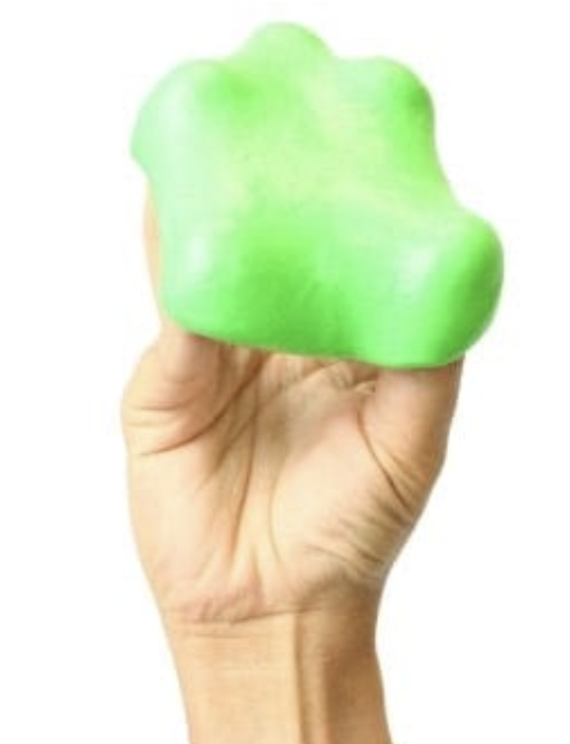
Grasp Stiffness
Luca Arleo, Anderson Nardin, Francesco Piqué
Contact us with questions at the #week3 Slack channel!
View “speaker notes” for details on each slide

Slide 2
What is “grasp stiffness” useful for?
It is a measure of how a grasped object will respond if perturbed by an external force.
It is one measure of the stability of a grasp.
It is used in Object Impedance Control in the Operational Space [Khatib]

Slide 3
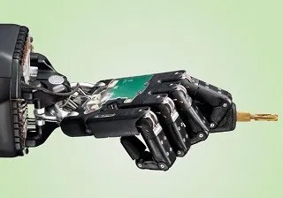
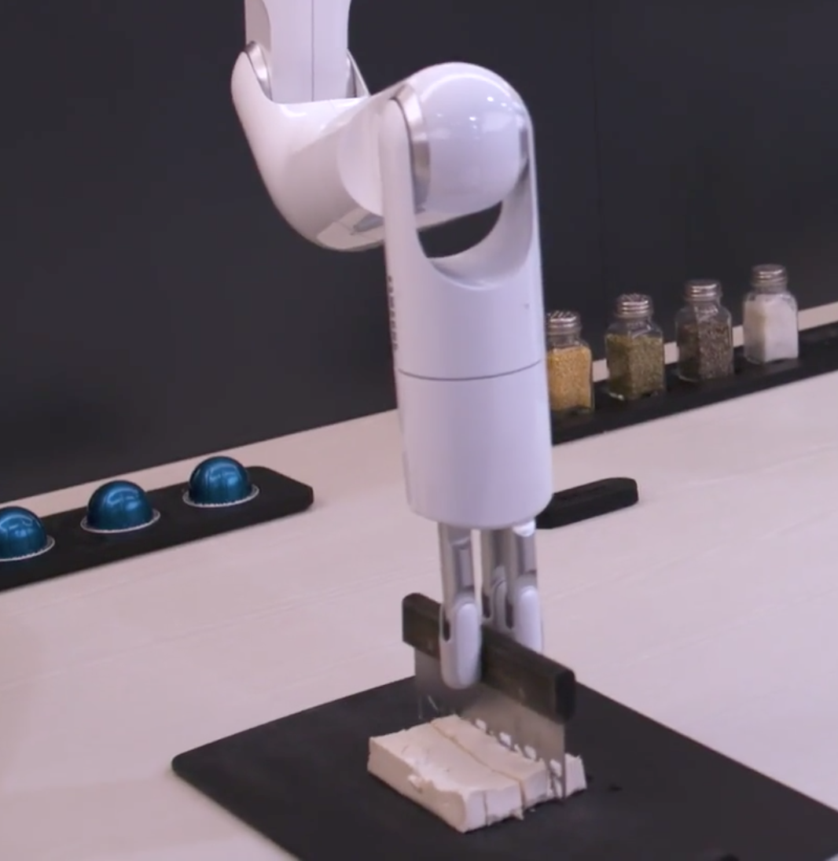
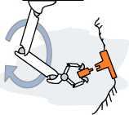
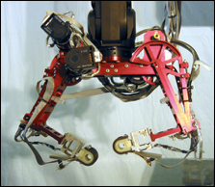
Background
Impedance control in operational space
Mapping of operational space impedance to joint impedances and vice versa
Wired Mag. “Let the robot drive” (2012)
CES 2020 Engadget on Samsung Bot Chef demo
Weston Griffin PhD Defense slides
Highly compliant task
High stiffness task
Notes:
When performing a robotic task where you use a robot hand to grasp an object and achieve a task with it you care about grasp stability and control of the compliance of this object. Some scenarios of this include the “peg in hole” task like inserting a key where you might want to control the object to be compliant.
In other cases you might want to control the object to have higher stiffnesses like seen at the right.
In general we call this “impedance control in operational space.” Why in operational space? Because these characteristics are defined in the object reference frame and are chosen to be relevant for a task.

Slide 4
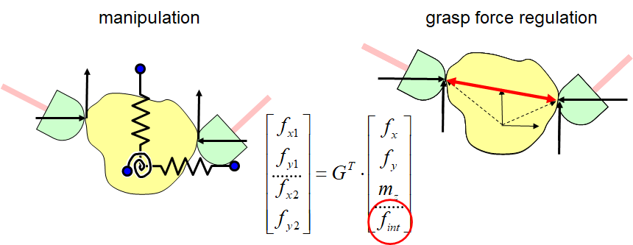
Dexterous Manipulation (review)
Notes:
manipulation:
the robot has the ability to position and orientate an object with in the robots workspace. This is of course subject to finger workspace limits and sensorized areas of the fingertips. The control of the position and orientation of the object is implemented by using an object impedance control

Slide 5
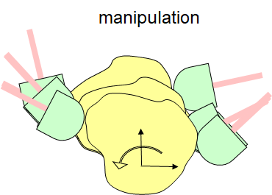
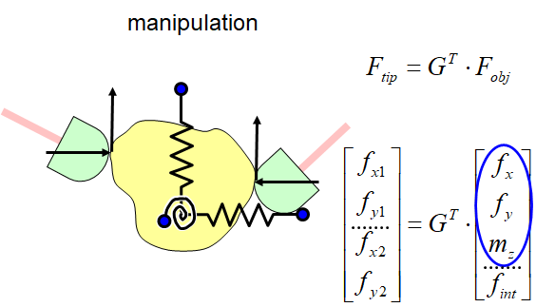
Dexterous Manipulation: object stiffness
Notes:
manipulation:
the robot has the ability to position and orientate an object with in the robots workspace. This is of course subject to finger workspace limits and sensorized areas of the fingertips. The control of the position and orientation of the object is implemented by using an object impedance control

Slide 6
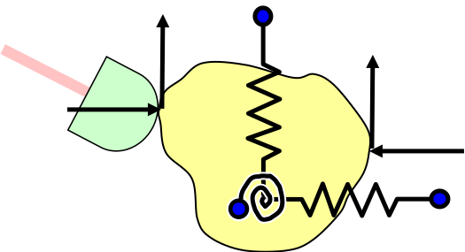
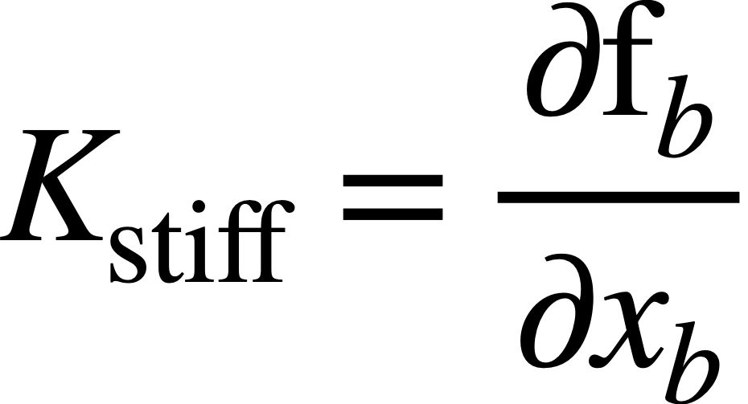
What is Grasp Stiffness Intuitively?

Slide 7
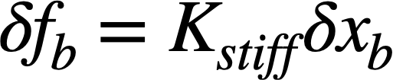
Grasp stiffness matrix
Grasp stiffness matrix effectively maps translations of the grasped object to forces that restore the object to its equilibrium.

Slide 8
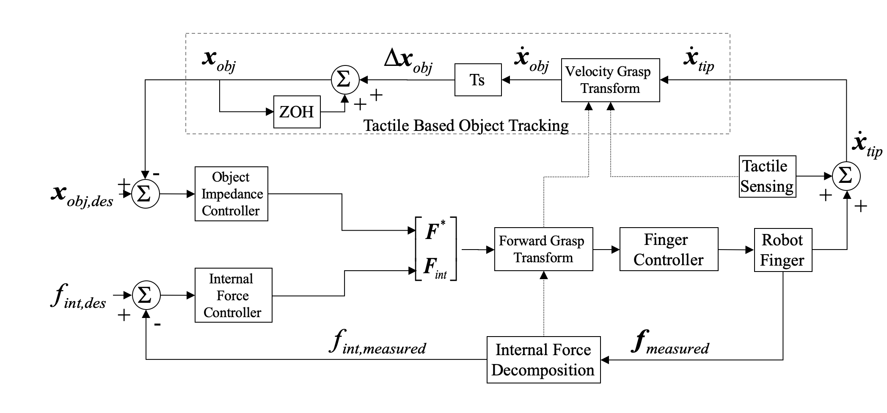
W. Griffin - object impedance control for a teleoperated hand
Notes:
Briefly walk people through this control system:
We specify a desired impedance (stiffness plus some damping) of the grasped object. This produces desired forces F* in response to position errors, Xobj of the object.
We combine these forces with grasp forces (internal forces) Fint – high enough to prevent slippage but not so high as to damage object.
We map those forces through the Grasp Transform to get finger forces
There is also a second path shown at top for using tactile information, which we will not get into for the moment.

Slide 9
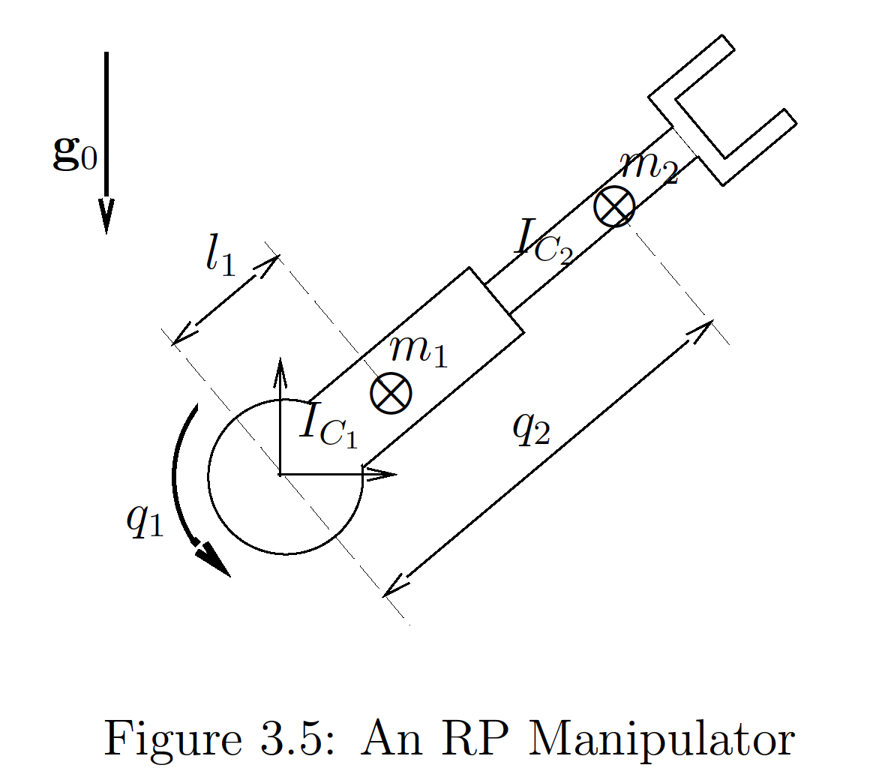
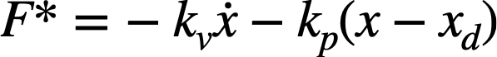
How about inertia and damping?
Joint Space Manipulator Equation of Motion:
Operational Space Manipulator Equation of Motion:
Control Scheme:
Oussama Khatib: CS 327A Advanced Robotics Textbook
Notes:
So why are we only talking about stiffness and not damping and inertia?
Like we might have learned in Intro to Robotics or Advanced Robotics, the equations of motion of a manipulator include terms involving inertia, coriolis and centrifugal terms. For those that might need a refresher on robotics, this equation is basically saying torque on the robot joints equals Inertia times angular acceleration plus a centrifugal and centripetal forces.
We can also look at it in the operational space formulation so that it matches the space in which we describe the grasp stiffness. F* is the typical PD control we use to move our robot to desired positions.

Slide 10
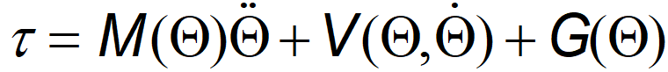
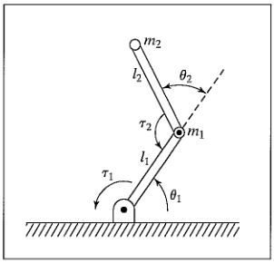
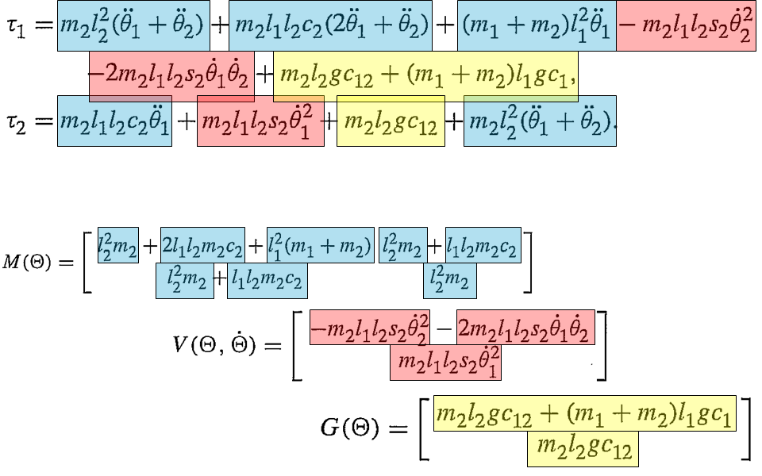
Dynamics equation
Coriolis Force
Craig: Introduction to Robotics
Centrifugal Forces

Slide 11
How about inertia and damping?
Joint Space Manipulator Equation of Motion:
Operational Space Manipulator Equation of Motion:
Control Scheme:
Oussama Khatib: CS 327A Advanced Robotics Textbook
Notes:
When we are looking at a grasp stability, the velocities and accelerations are pretty small. We mainly care about whether a particular choice of grasp configuration (which includes contact points, friction and joint stiffnesses) will yield a good or stable grasp.

Slide 12
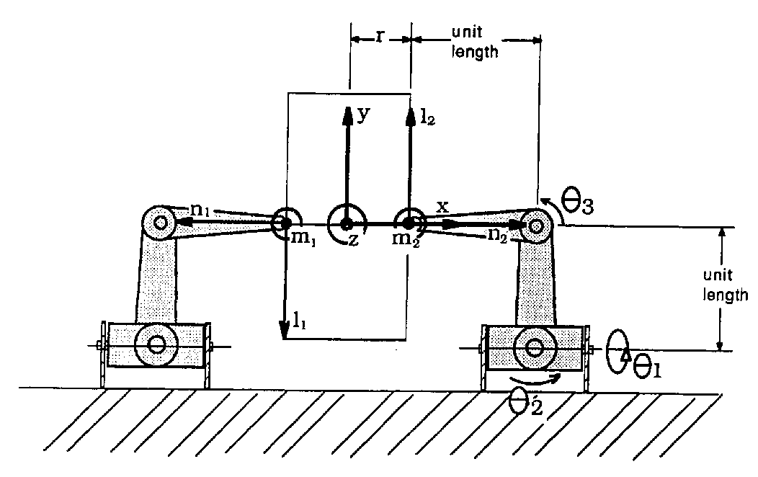
Important Components in a grasp
Object reference frame B
Axis x, y, z
Body Contact reference frame P
Axis l₁,m₁,n₁ and l₂,m₂,n₂
Fingertip reference frame F
Joint space Θ
Notes:
Before we talk about how we go about finding the grasp stiffness, let’s dissect the main components of a grasp.
Here talk about three important coordinate spaces. Object reference frame, contact point reference frame and finger joint space.

Slide 13
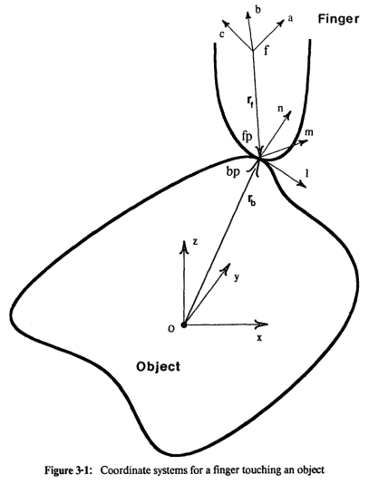
Important Components in a grasp
Object reference frame B
Body Contact reference frame P
Fingertip reference frame F
Axis a,b,c
Joint space Θ
Notes:
Here talk about three important coordinate spaces. Object reference frame, contact point reference frame and finger joint space.

Slide 14
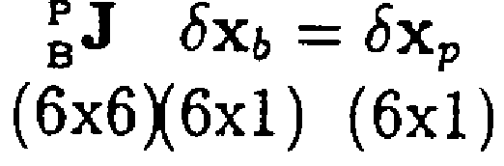
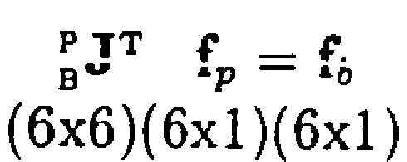
Important Components in a grasp
Object reference frame B
Body Contact reference frame P
Fingertip reference frame F
Joint space Θ
Notes:
J: Coordinate transformation matrix
Here talk about three important coordinate spaces. Object reference frame, contact point reference frame and finger joint space.

Slide 15

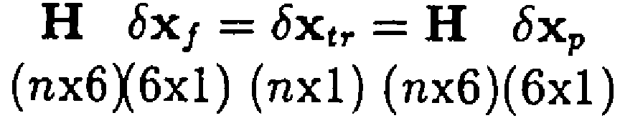
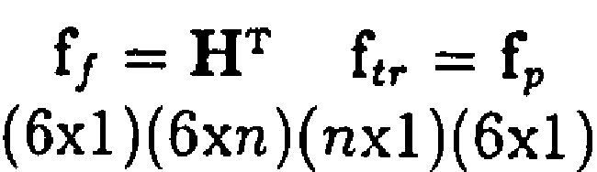
Important Components in a grasp
Object reference frame B
Body Contact reference frame P
Fingertip reference frame F
Joint space Θ
Notes:
H: Contact constraint matrix
Here talk about three important coordinate spaces. Object reference frame, contact point reference frame and finger joint space.

Slide 16
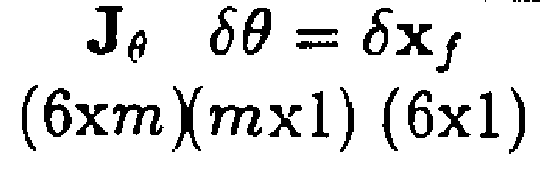
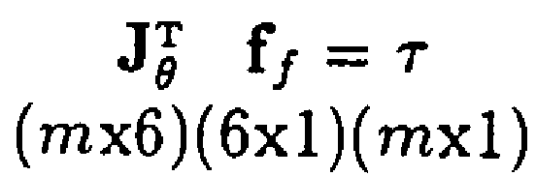
Important Components in a grasp
Object reference frame B
Body Contact reference frame P
Fingertip reference frame F
Joint space Θ
Notes:
J_theta: Joint Jacobian matrix
Here talk about three important coordinate spaces. Object reference frame, contact point reference frame and finger joint space.

Slide 17
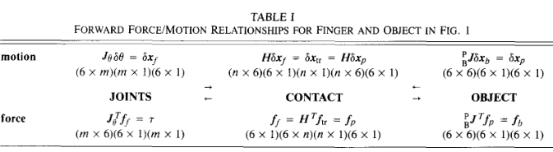
Important Components in a grasp

Slide 18
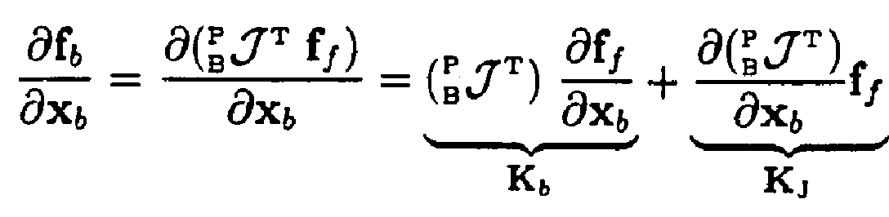
Revisit Definition of Grasp Stiffness
Direct stiffness
Geometric stiffness
Notes:
We concatenate J, H, and etc, so that we can simultaneously express the force/motion relationships for all the fingers of a grasp. The new equations have the same form as those in Table I

Slide 19
Switch from Anderson to Francesco

Slide 20
Revisit Definition of Grasp Stiffness
Notes:
Restoring forces at the contact points resulting from the structural and servo stiffness of the fingers

Slide 21
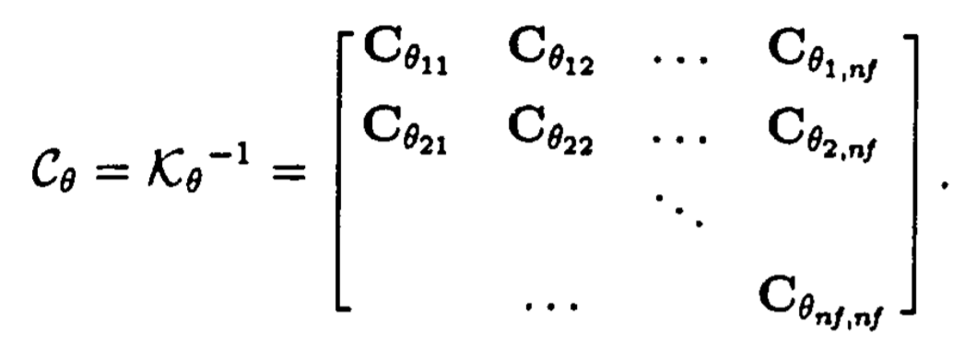
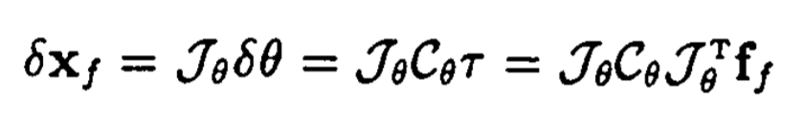
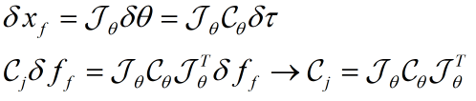
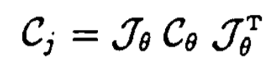
Finding the Direct Stiffness - Joint Compliance
Idea: Look at each finger individually. Start at the joints and work our way to the fingertip. Adding joint compliance and structural compliance.
Compliance at the fingertips due to the servo compliances.
Notes:
We work with compliances instead of stiffness because compliance adds when connected serially (we are working with a serial chain, single finger) (and stiffness adds when connected in parallel).
For each finger we want to add the compliance of the joint and the compliance of the structure working from the joints to the fingertip.This compliance can be partly from joint servoing and partly from passive structural compliance (e.g. soft fingertips).
Definition of jacobian
Definition of compliance
Definition of stiffness

Slide 22
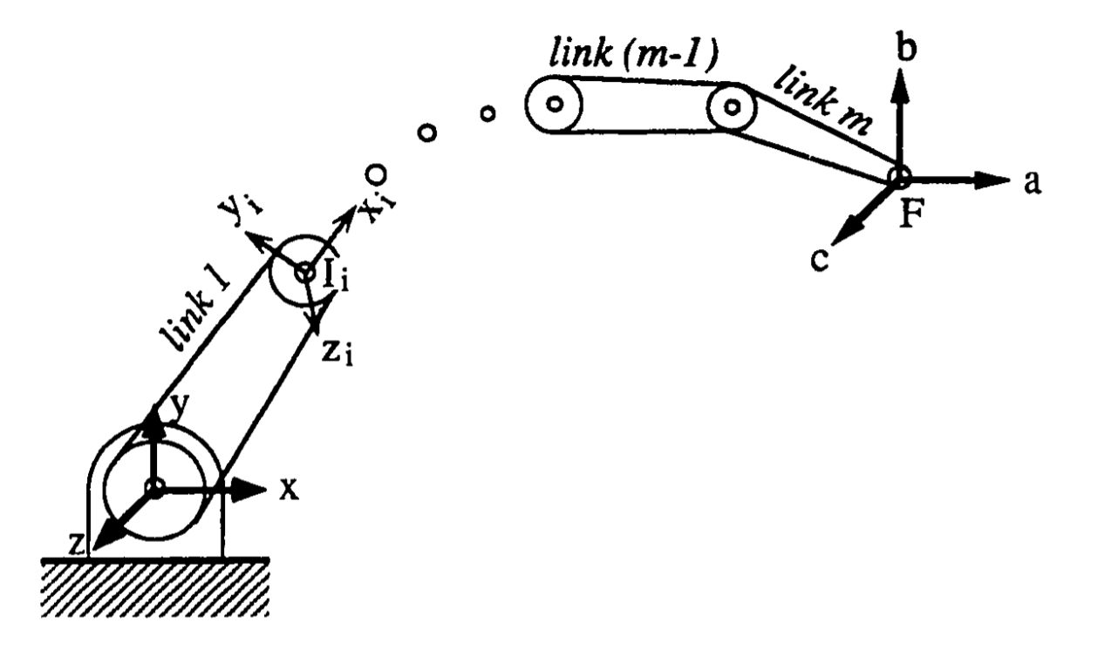
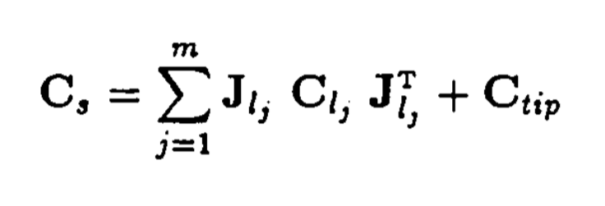
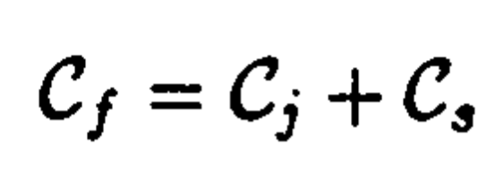
Finding the Direct Stiffness - Structural Compliance
Link compliance
Cartesian transformation matrix relating a frame in the j-th link to the F(a,b,c) frame at the fingertip
Tip compliance
Total compliance at the fingertip:
Compliances in series add
It is numerically easier to model zero compliance than infinite stiffness

Slide 23
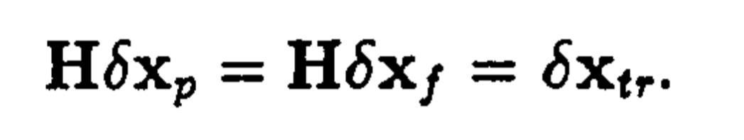
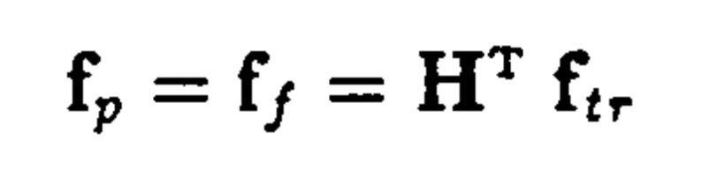
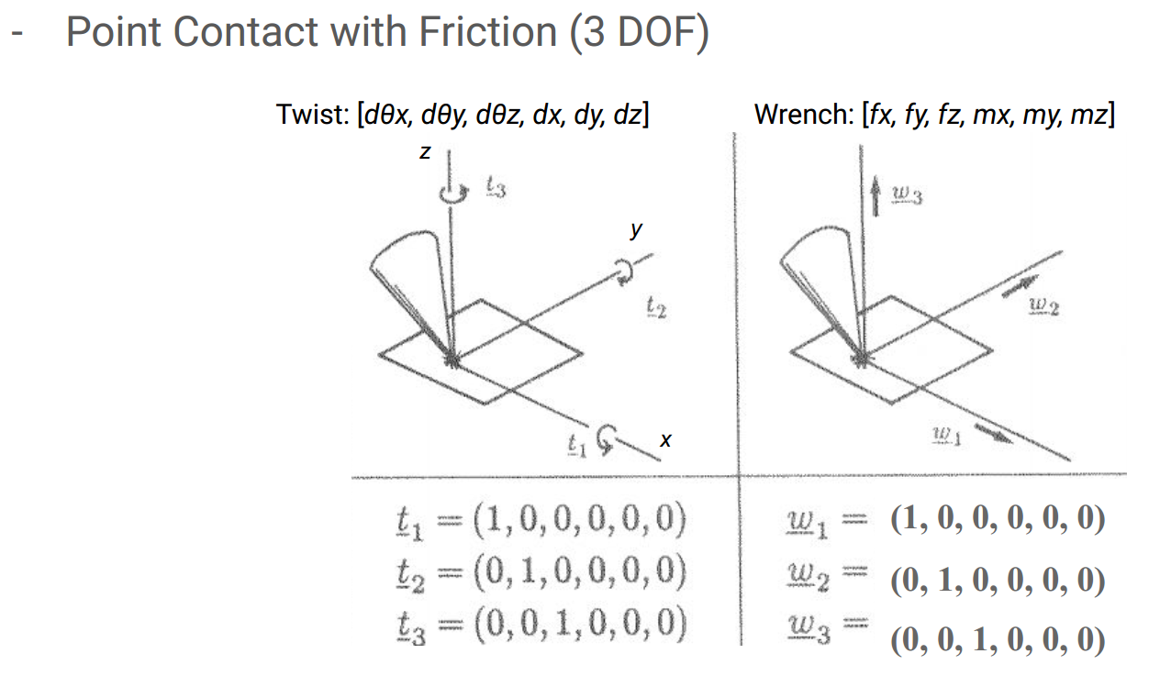
Finding the Direct Stiffness - Contact Matrix
<=
<
[
]
= H
Notes:
This [H] matrix thing is essentially the same as what we saw in Salisbury’s contact wrench matrices.

Slide 24
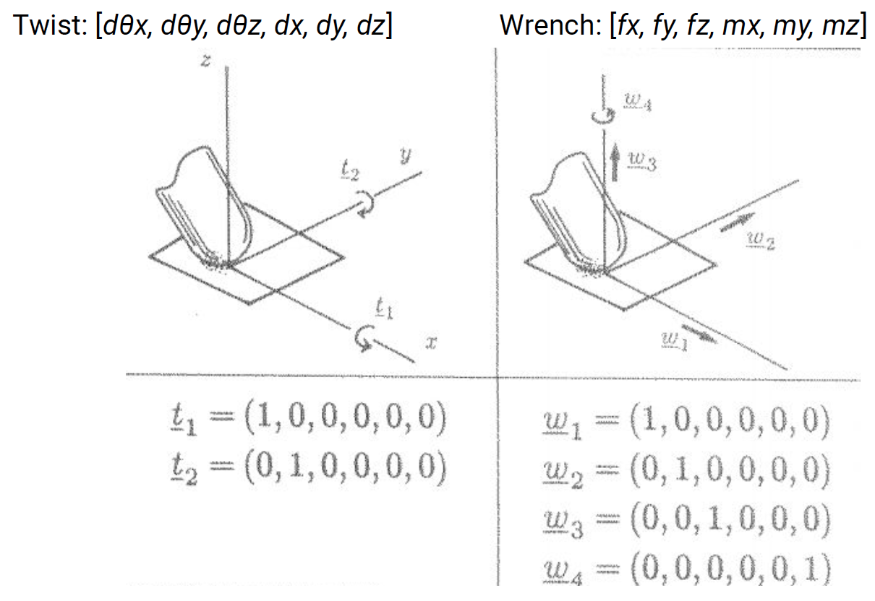
Finding the Direct Stiffness - Soft Finger Contact
[
]
= H

Slide 25
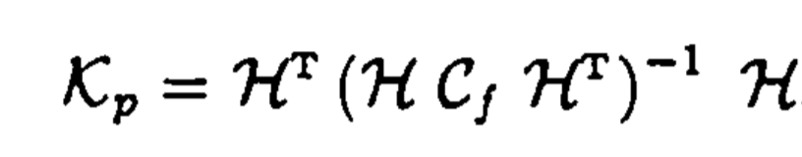
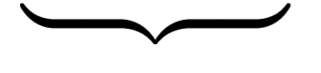
Finding the Direct Stiffness - Contact Stiffness
Stiffness for the contact point on the object
Finger stiffness components seen through the contacts
We pass the compliance matrix through the contact matrix so that we have an invertible matrix
Invert the stripped compliance matrix to get the finger stiffness
Pass the finger stiffness matrix through the contact matrix to get the stiffness of the contact point on the object.
Notes:
This looks a bit complicated… We start with the fingertip compliance, [Cf]. We pre- and post-multiply by [H], [H]^t it to get the corresponding compliance terms that are actually transmitted through the contact. The pre- and post multiply is because the [H] matrices work similarly to Jacobians [J] with stiffness or inertia.
You get a quadratic form because the [H] matrix is involved both for the small motions and the corresponding small forces.
Then we invert this to get the corresponding contact stiffness matrix [Kf]. And finally pre- and post-multiply again to get the corresponding contribution of the finger contact to the both contact stiffness.
This slightly complicated sequence is because if there are degrees of freedom that are free to rotate, they will have “infinity” compliance, which is not defined. Similarly if there are degrees of freedom that are constrained they would have infinity stiffness.
So we take the inner term (H*Cf*H’) and invert it. This gives us a stiffness in contact space. But it might only be a 3x3 stiffness matrix, for example, if we have point contact. So before we add the stiffnesses of the contacts we want to expand back out to a full 6x6 matrix (which will probably have some zero rows and columns. Then we add the expanded 6x6 stiffness matrices, transformed to the body frame.

Slide 26
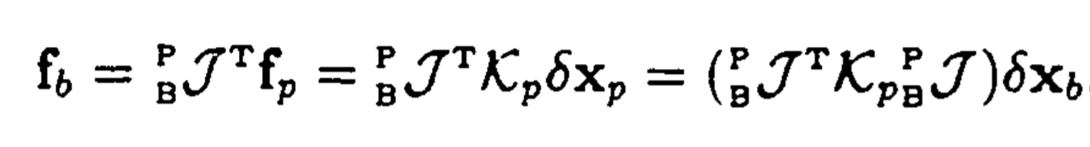
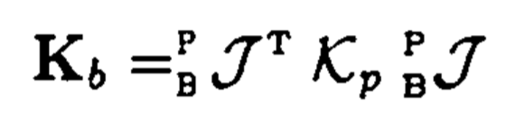
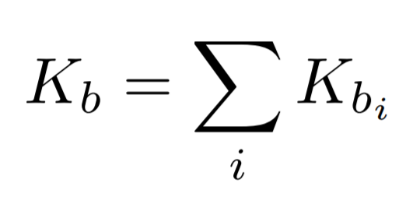
Finding the Direct Stiffness - Body Stiffness
Stiffnesses in parallel add
Notes:
Once we get the stiffness contribution of every contact, on the body side, we can simply add them, transposing them to the common body frame.

Slide 27
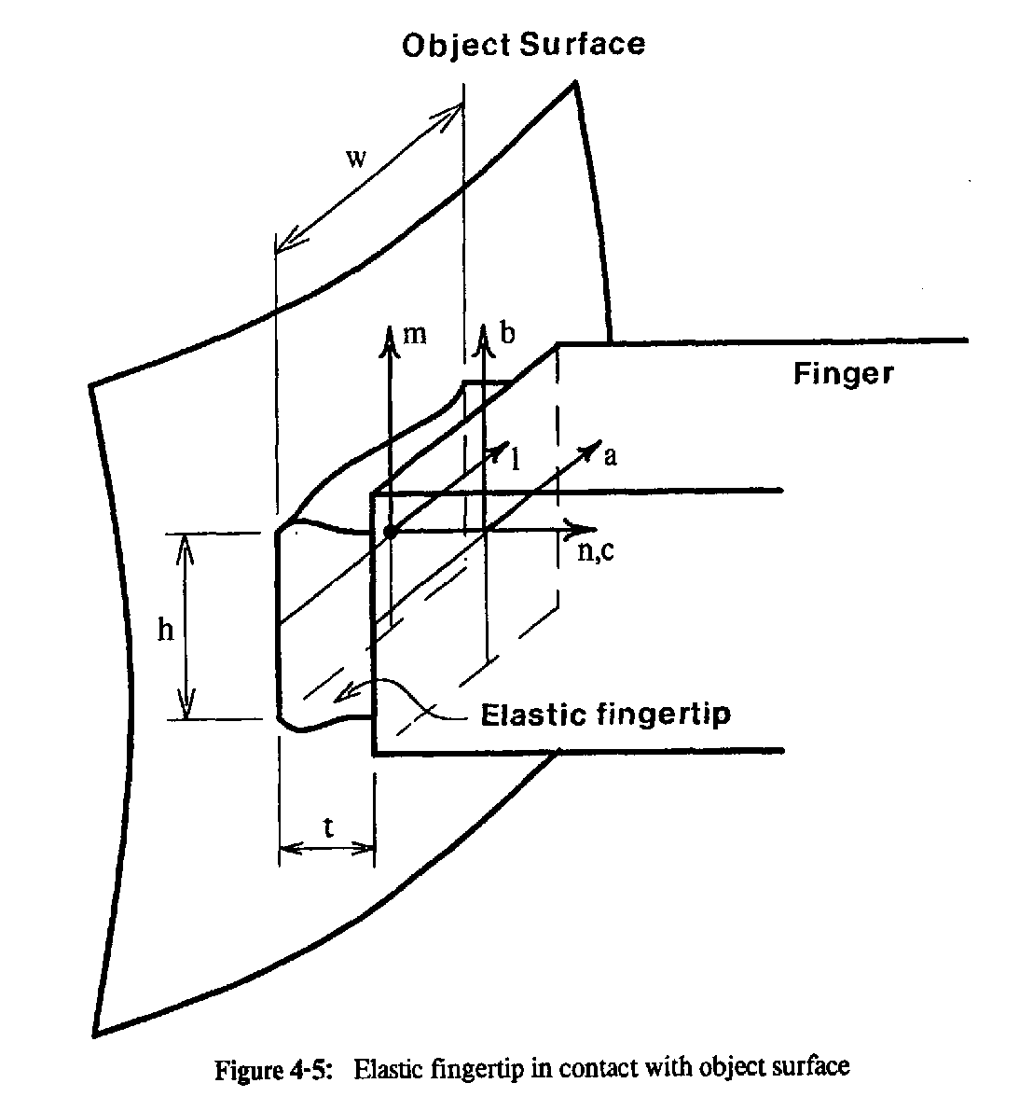
What changes with a soft or very soft fingertip?
Notes:
Soft finger (Salisbury): [H] will have an extra term for rotations transmitted around the local normal axis.
Very soft finger (Cutkosky) - this is for things like particle jamming fingertip or suckers. Now [H] is simply a 6x6 identity matrix.

Slide 28
Switch from Francesco to Luca

Slide 29
Finding the Geometry Stiffness
Notes:
Demonstrate the rolling effect with the circular puck!

Slide 30
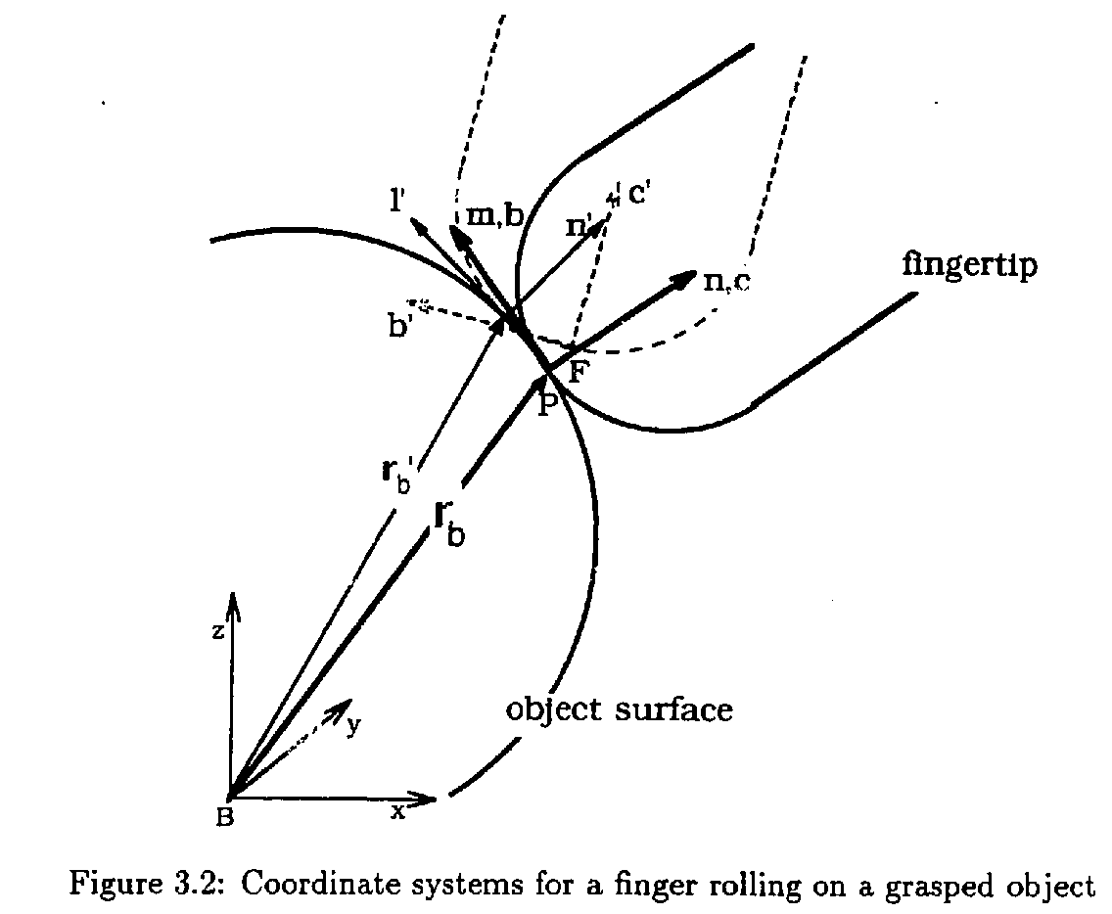
Intuition on Geometry Stiffness
Idea: Small motions of the object will cause the contact points to change. This in turn will create a new Jacobian affecting how finger wrenches map to object wrenches.
Think of the coin-snap example!
Notes:
The issue is that the grasp forces could be large, so even if they are multiplied by small terms the effect is not negligible.

Slide 31
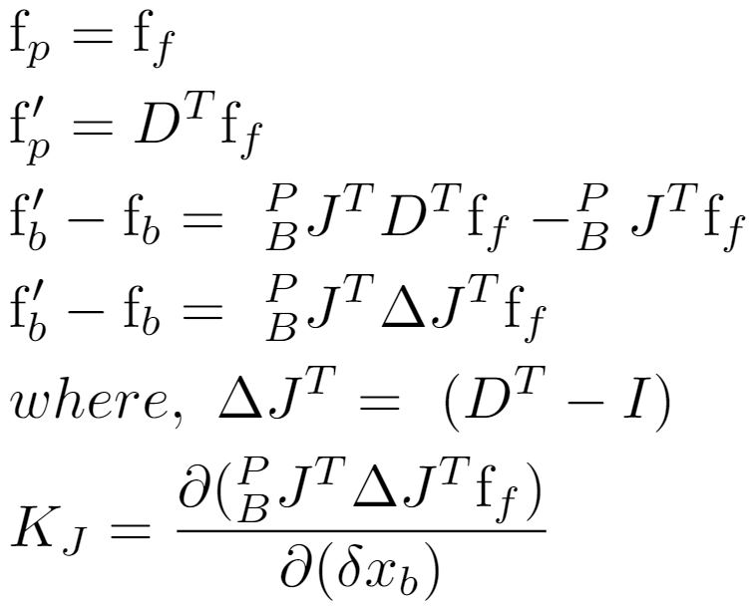
Finding the Geometry Stiffness: Differential Jacobian
A transformation between the initial contact coordinate system and the new position and orientation after a small motion has taken place.

Slide 32
Finding the Geometry Stiffness: Differential Jacobian

Slide 33
What is in your python example:
dfbody1 = -Jb1t*dJtran1p*fgrasp
print("Change in force on body due to small geometry change [dfbody]")
pprint(dfbody1)
""" You will add the corresponding terms for the right finger above and then
get the total change in the body force. Then you can use sympy to take
the jacobian of dfbody with respect to bodytwist to get [Kj]
"""
#dfbody = simplify(dfbody1+dfbody2)
#Kj = dfbody.jacobian(bodytwist) #Matches Kj in eq (30) Cutkosky&Kao

Slide 34
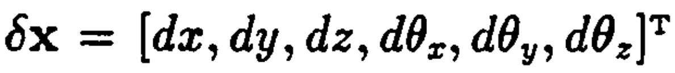
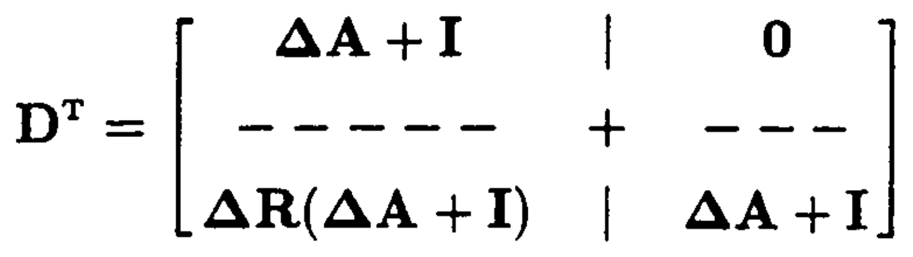
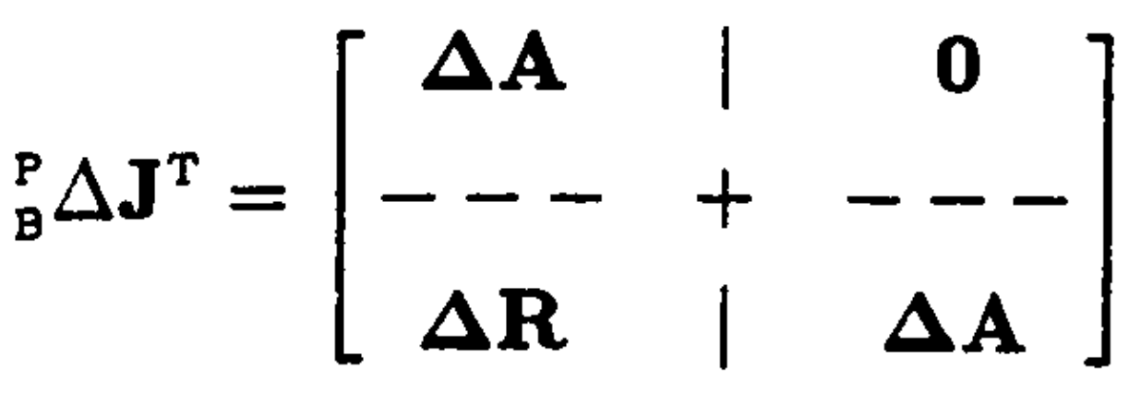
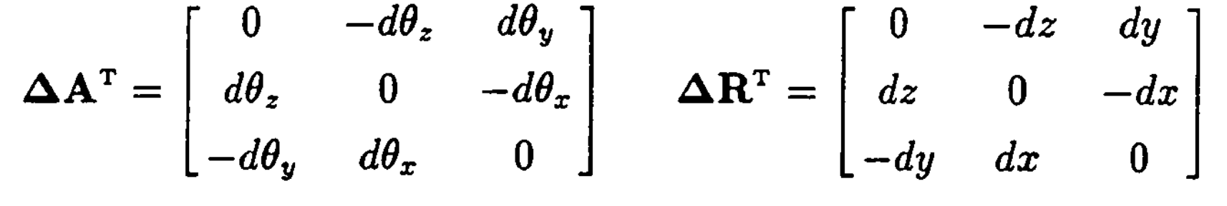
Finding the Geometry Stiffness: Differential Jacobian
If we write the change in position and orientation of the frame as the contact moves as:
The matrix transformations can be expressed as:
Notes: Second order terms are neglected. The paper may erroneously have transposes on A and R definitions in the Appendix, but final result is ok..

Slide 35

Grasping Kinematic loop (from week 1)
(forward transform)
(inverse transform)
Notes:
We start at the lower right corner and work our way around following the arrows. Some of the transformations are forward kinematics, some are inverse.

Slide 36


Finding the Geometry Stiffness:
Propagating Motion from Object to Joints

Slide 37



Finding the Geometry Stiffness:
Propagating Motion from Object to Joints
At this point, we may not know fully because only some motions of are transmitted through the contact

Slide 38


Finding the Geometry Stiffness:
Propagating Motion from Joints to Object

Slide 39

Finding the Geometry Stiffness:
Solving for the frame transformation

Slide 40

Finding the Geometry Stiffness:
Take the partial

Slide 41

Total Grasp Stiffness

Slide 42

Setup for the assignment
We provide some Sympy code for the left finger. You add the right finger and compute Kb and Kj and confirm they match the results in the paper. (Do in sympy or convert to symbolic Matlab).
Then consider what happens if the fingertips have a radius of curvature, r, (hemispherical) with rolling.
Then consider what happens if the fingertips are soft, with ‘soft finger’ contact and with additional bending and torsional structural compliance at the fingertips. Ignore rolling in this case.
Top and front views of two fingers, each with 3 joints, holding a block. Finger links are at right angles

